Slide 1
DSPG 2019
TOSS Updates
Gizem Korkmaz, Bayoan Calderon, Brandon Kramer, and Aaron Schroeder
DSPG: Cong Cong, Calvin Isch, Eliza Tobin
Sponsor: Carol Robbins, National Science Foundation, National Center for Science and Engineering Statistics

Slide 2
Outline
OSS Definition
Problem Statement
Universe Definition
Licenses
Data Source: GitHub
Data Collection Methods
Final Dataset Coverage
Copyrights (if needed)
Interpretation of Findings
Notes:
Defining and measuring the universe of ope source software innovation: What is OSS? What is a universe?
Universe: scope right now is U.S. even though we acknowledge that OSS often has no boundaries – relevant to the issue of economic measurement in U.S. so focusing on that right now
NOTES: is copyright a good measurement of OSS innovation?
-add foreign sector
Software License: "A software license tells others what they can and can't do with your source code" (Github)

Slide 3
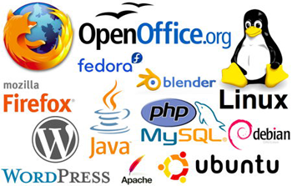
OSS Definition
Open Source Software (OSS): "a computer software, with its source code made available with a license, in which the copyright holder provides the rights to study, change, and distribute the software to anyone and for any purpose." (Open Source Initiative)
It is developed
• within and outside of the private sector • universities (e.g., Stanford, MIT, UC-Berkeley), businesses (e.g., Microsoft, Google), government research institutions (e.g., Sandia National Lab), nonprofits, and individuals
Notes:
Eliza
Defining and measuring the universe of ope source software innovation: What is OSS? What is a universe?
Universe: scope right now is U.S. even though we acknowledge that OSS often has no boundaries – relevant to the issue of economic measurement in U.S. so focusing on that right now
NOTES: is copyright a good measurement of OSS innovation?
-add foreign sector
Software License: "A software license tells others what they can and can't do with your source code" (Github)

Slide 4

Measuring the Universe of OSS
Problem Statement: There are no commonly used metrics to measure the amount of open source software (OSS) in existence and current NCSES and other economic indicators do not measure the value of open source software outside the business sector.
Goals: To measure
How much open source software is in use? (stock measure)
How much is created each year? (flow measure)
Who creates it? (Sectors: Business, Government, Academia, Households, Nonprofits, Foreign)
Notes:
ISSUE:
current economic indicators do not measure the value of goods and services that do not have market transactions
not captured in surveys nor are in economics measures such as the Gross Domestic Product (GDP).
Want a fuller understanding of innovation/OSS innovation
GOALS
Measure the amount of OSS data in existence, especially for purposes of longitudinal comparison
Origin: who creates OSS? What is distribution across different groups? - identify 5 sectors: we care because business OSS
OSS is a type of research output (there is money going into this but OSS is not captured when we look at the ROI on these projects) that comes not only from businesses but other sectors: important to gain a better understanding of this type of research output

Slide 5

OSS Definition & The Significance of GitHub
Universe: GitHub Repositories that have a registered Open Source Initiative (OSI) approved license.
"[P]retty much everyone hosts their open source projects on GitHub, including Google, Facebook, Twitter, and even Microsoft" -Wired Magazine 2015
Notes:
86 OSI approved licenses
OSI: raise awareness and adoption of open source software, and build bridges between open source communitiesof practice
Defining and measuring the universe of ope source software innovation: What is OSS? What is a universe?
Universe: scope right now is U.S. even though we acknowledge that OSS often has no boundaries – relevant to the issue of economic measurement in U.S. so focusing on that right now
NOTES: is copyright a good measurement of OSS innovation?
-add foreign sector
Software License: "A software license tells others what they can and can't do with your source code" (Github)

Slide 6
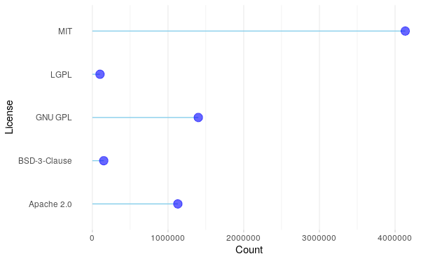
Licenses
Licenses: Define the limitations of use for OSS and provide developers with claims when licenses are violated.
Licenses vary based on limitations placed upon users
Commonly Used Licenses: MIT, GPL, APACHE, BSD
Top Licenses by Amount Registered on GitHub
Amounts recorded as of July 2019.
Source: GraphQL
Notes:
Eliza
A bit bigger fonts
And sort by count
Shares of all licenses

Slide 7

Methods for Accessing GitHub Data
We tried several approaches, each with benefits and limitations:
RestAPI
"The person who doesn't know when to stop talking"
Access a lot of hard to use information
Can't specify what you want
Graph QL
"The iPhone—great but need a new one every two years"
Easy access to the exact information you want
Need to limit the amount of data you request to first thousand
pagination within pagination
Breaks randomly
Web Scraping
"Float like a human, sting like a computer"
Slow & Messy Data
Notes:
Rest API: broken fire hose

Slide 8
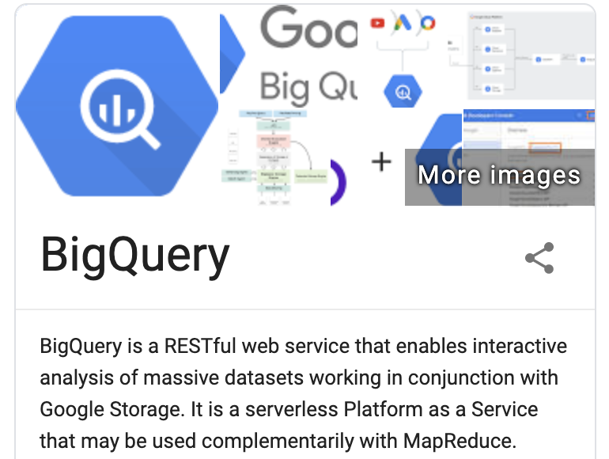
Methods for Accessing GitHub Data
Existing Data Sets:
BigQuery
"An HP in Mac's clothing"
Looks nice
Not frequently updated
GHTorrent
Chipotle - "Almost everything you want but not quite"
Scrape GitHub daily and have an accessible full RestAPI database
Missing License information, and additions and deletions

Slide 9
Our Approach
Why choose when you can have the all?
We need info on (1) how much OSS is out there (2) how does it change over time (2) who is creating it and where are they
1. GraphQL query all repos for licenses (<1k at a time)
2. Merge with GHTorrent variables to look at raw number, location/organization, and size by commits
3. Begin Web scraping by specific repositories to get additions and deletions

Slide 10
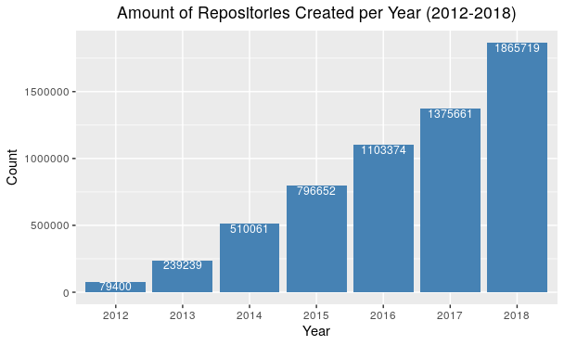
The Growth of OSS
Total Number of OSS Repositories by Year:
Year | Repository Count
2012 | 79,400
2013 | 239,239
2014 | 510,061
2015 | 796,653
2016 | 1,103,374
2017 | 1,375,661
2018 | 1,865,720

Slide 11
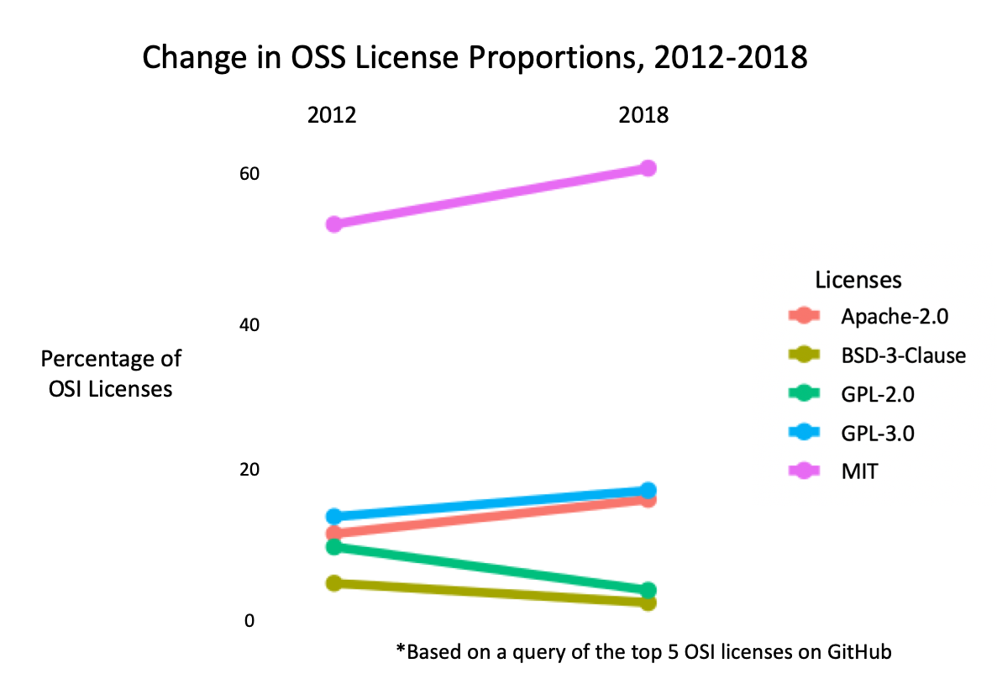
Permissive Licenses are More Active
Notes:
MIT most permissive
GPL more restrictive

Slide 12
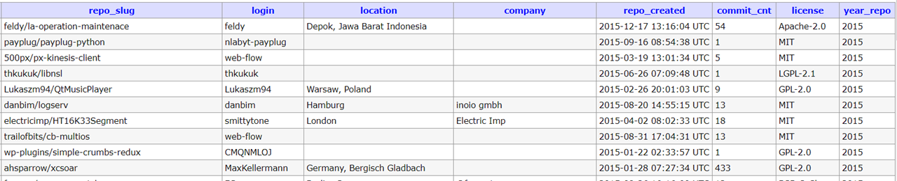
Data Overview
Repository Slugs: owner login name + repository name
Login: contributors to this repository
Location: self-reported locations of contributors
Company: self-reported companies/organizations of contributors
Repository created date: the date when the repository was created
Commit Counts: total commits up to April 2018
License: the OSI-approved license name

Slide 13
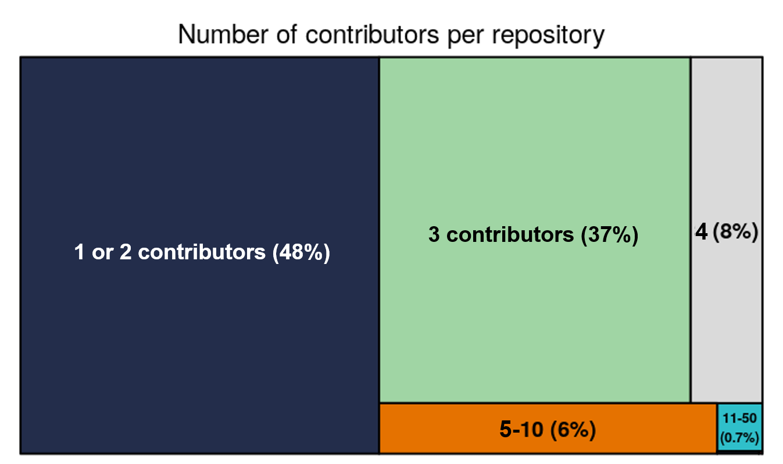
Contribution
On average 1.94 contributors work on one OSS repository. Even though there are repos that are contributed by thousands of collaborators, most of them are maintained by 1-2 people.

Slide 14
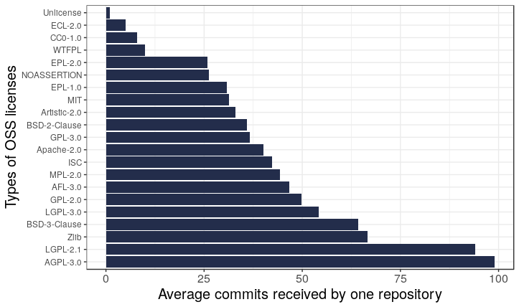
Contribution
On average one repository receives 36.5 commits.
The average number of commits by license shows the activity of different types of OSS projects
Notes:
Do it for all overall
Carol: How much of contribution from each person

Slide 15
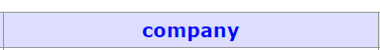
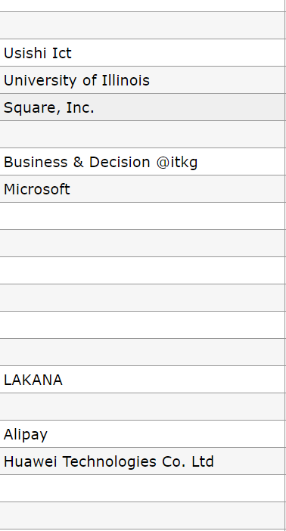
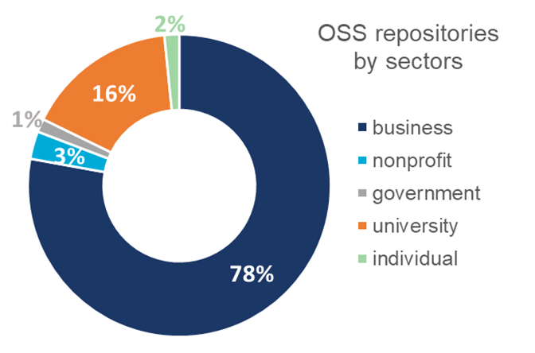
Sectors

Slide 16
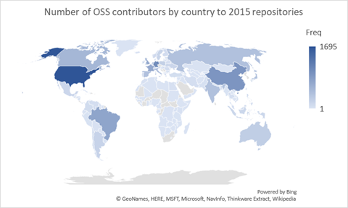
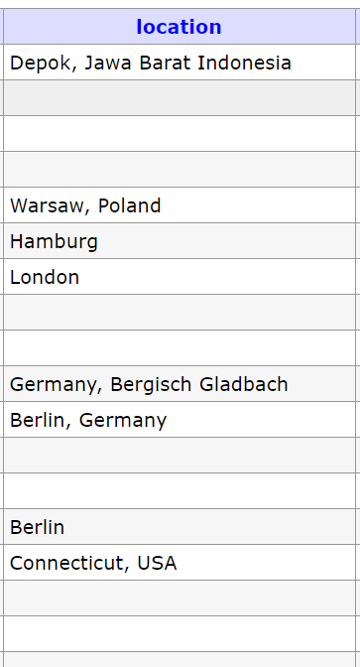
Locations
Number of OSS contributors by country

Slide 17
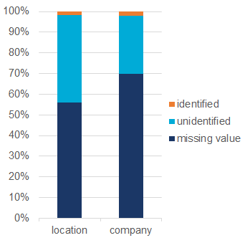
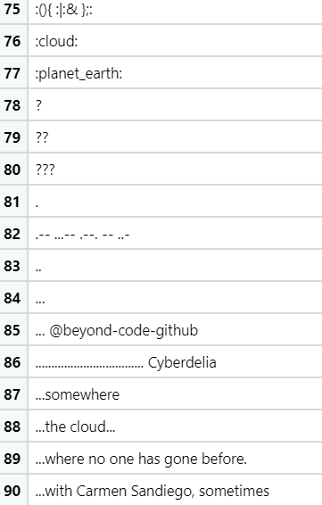
Limitations of Identifying Locations and Sectors
Missing value
Input text that can't be identified
We can only identify about 2% of the users' locations and sectors.
Notes:
Based on the profile when they created the account
Email: get through git repository, company

Slide 18
Copyrights

Slide 19
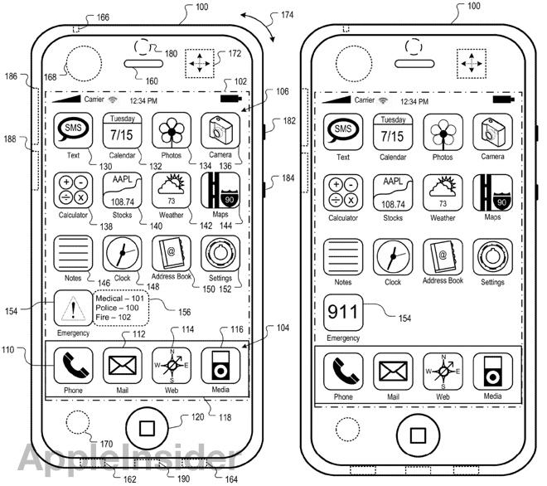


Do Traditional Measures Capture the Universe of OSS Innovation?
Is there a need to reinvent the wheel?
Three traditional ways to register innovation:
Trademark Patent Copyright
Notes:
Eliza
People have licenses to define limitations of how other people can use their software (terms of use), people also register the products so that people can have claims when licenses are violated... there are 3 traditional ways to register innovation
3 typical ways to register innovation/products --> 3 traditional ways innovation is measured: copyright, trademark, patent

Slide 20

Copyright Data Discovery
First step: investigate software copyrighted in U.S.
Copyright: "a form of protection provided by the laws of the United States to the authors of ‘original works of authorship’ that are fixed in a tangible form of expression” (U.S. Copyright Office)
Why?
Accessible
Some copyrighted computer files are OSS
Is Copyright a Good Measure of the Universe of OSS?
Notes:
Cong
Decided to look at computer file copyright on copyright.gov because it is accessible – will look at the other two next
Some copyrighted computer files are OSS
Good way to measure universe of OSS?
Also wanted to see if computer file copyright was a good way to measure OSS innovation – is computer file copyright a good candidate for our universe?

Slide 21
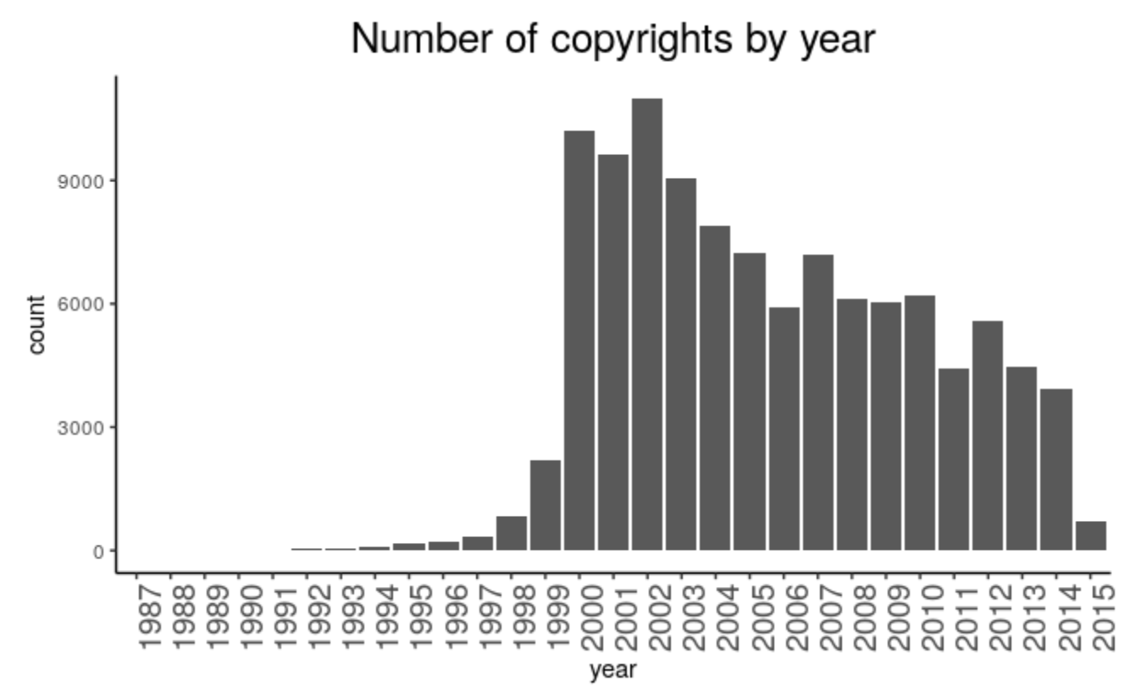
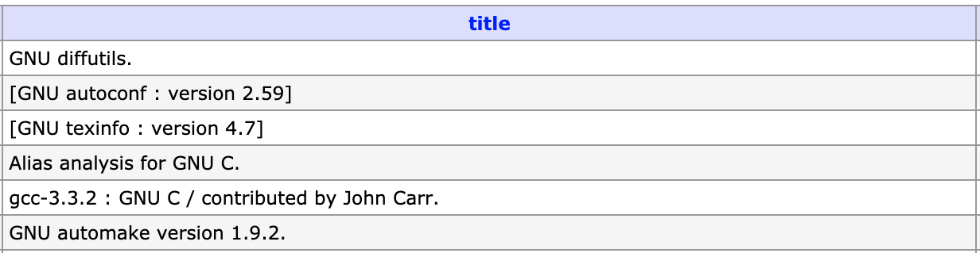
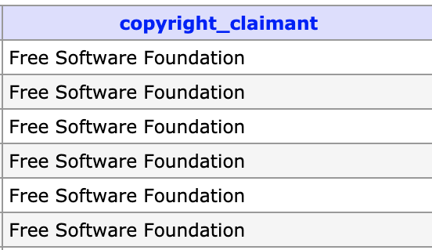
Findings:
Difficulties finding OSS in the decreasing copyrights
Identifying OSS in the data
Queried the database for OSS-identifiable characteristics
Typical terms: "OSS", "Free Software"
Large Programs: R, Python, Android
55
The number of computer-file copyright applications is decreasing
Identified in copyright data
Notes:
Give examples of some of the identified OSS

Slide 22
Conclusions
1. OSS is growing.
2. OSS is becoming more permissive.
3. GitHub captures a large share of OSS in existence.
4. Even with perfect information on GitHub, sectors will be difficult to identify.
Notes:
Give examples of some of the identified OSS
Matplotlib

Slide 23

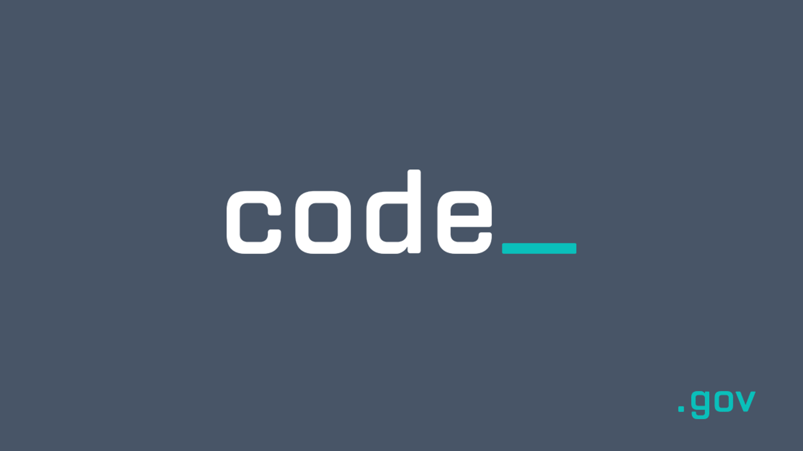

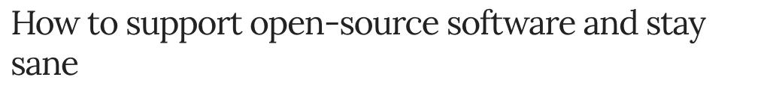
Conclusions (continued)
5. We need better standards for tracking and recognizing OSS producers.
6. Traditional measurements of innovation (EX: copyrights) are not good measures of OSS.
.edu
Notes:
Give examples of some of the identified OSS
Matplotlib

Slide 24
DSPG 2019
Thank you!
Gizem Korkmaz, Bayoan Calderon, Brandon Kramer
DSPG: Cong Cong, Calvin Isch, Eliza Tobin
Sponsor: Carol Robbins, National Science Foundation, National Center for Science and Engineering Statistics

Slide 25
Appendix – extra slides

Slide 26

Defining and Measuring the Universe of Open Source Software (OSS) Innovation
SDAD Team: Gizem Korkmaz & Bayoán Santiago Calderon
Sponsor: Carol Robbins, National Science Foundation (NSF) National Center for Science and Engineering Statistics (NCSES)

Slide 27

Project Overview
Open Source Software (OSS) is a computer software with its source code made available with a license in which the copyright holder provides the rights to study, change, and distribute the software to anyone and for any purpose [Open Source Initiative, 1998].
• within and outside of the private sector • universities (e.g., Stanford, MIT, UC-Berkeley), businesses (e.g., Microsoft, Google), government research institutions (e.g., Sandia National Lab), nonprofits, and individuals
Current NCSES and other economic indicators do not measure the value of open source software outside the business sector
Importance of quantifying coding impact in the scientific community
Citations are used to measure the impact of patents and publications which are most frequently used to estimate the research outputs of universities and government institutions.
The goal is to test the feasibility and to develop methods to measure the impact and scope of open source software
DSPG Summer 2019

Slide 28
Research Questions
How much open source software is in use? (stock measure)
How much is created each year? (flow measure)
What types can be identified?
Who creates it? (Sectors: Business, Government, Academia, Households, Nonprofits, Foreign)
What sources of data and variables could serve as proxies for measuring attributes and economic value of open source software?
Counts of OSS, by sector (e.g., university, government), by technology
Attributes, e.g., # citations, #downloaded, languages, etc.
DSPG Summer 2019

Slide 29
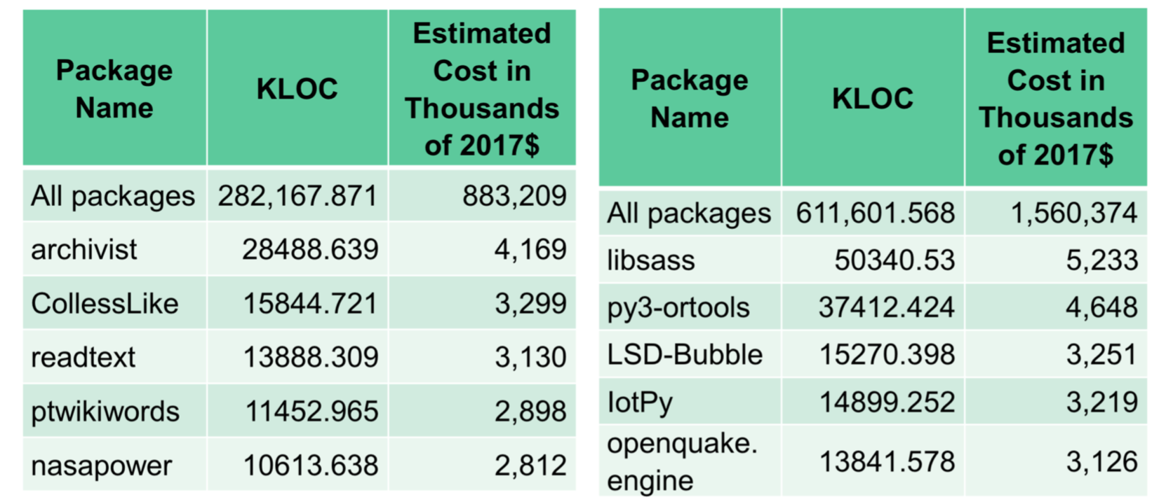
Prior Work
• Cost of Software Package Creation
Identify number of people involved each package’s development;
Estimate time spent on software development;
Use average compensation for computer programmers;
Estimate intermediate inputs based on BEA (Bureau Economic Analysis) and OECD (Organisation for Economic Co-operation and Development) methodologies.
Cost of R and Python Packages developed on GitHub
DSPG Summer 2019

Slide 30
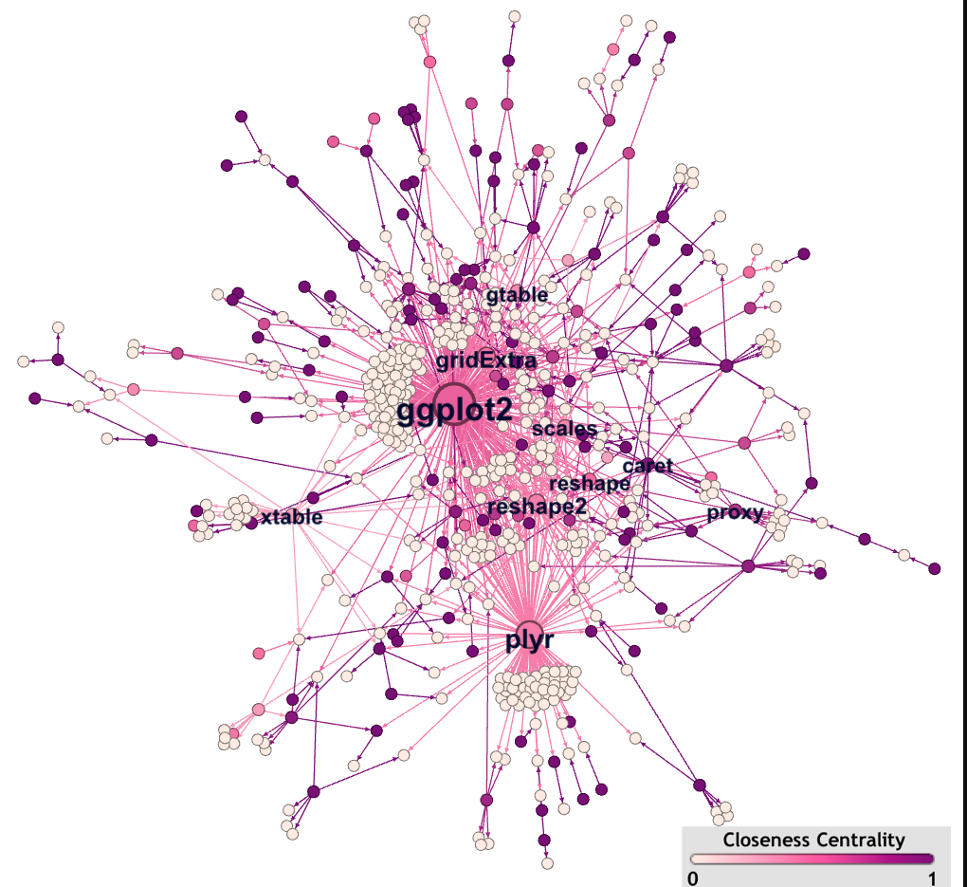
Summer Project Goals & Deliverables
What is the Universe of OSS?
Discovering and collecting information on software projects that have a copyright and/or a trademark in the US.
Data Sources:
USPTO trademark and patent data
Library of Congress Copyright data (scraping)
Data Analysis: contributions by sector (business, university, government, household), and by geography.
Using ORCID database to find information on developers of R packages that are registered on CRAN.
DSPG Summer 2019
Analyze interactions between contributors and the diffusion of OSS innovation across institutions and sectors using dependency and contributor networks.

